Slide 1
Chapter 5
Thermochemistry

Slide 2
Energy
Energy is the ability to do work or transfer heat.
  Energy used to cause an object that has mass to move is called work.
  Energy used to cause the temperature of an object to rise is called heat.

Slide 3
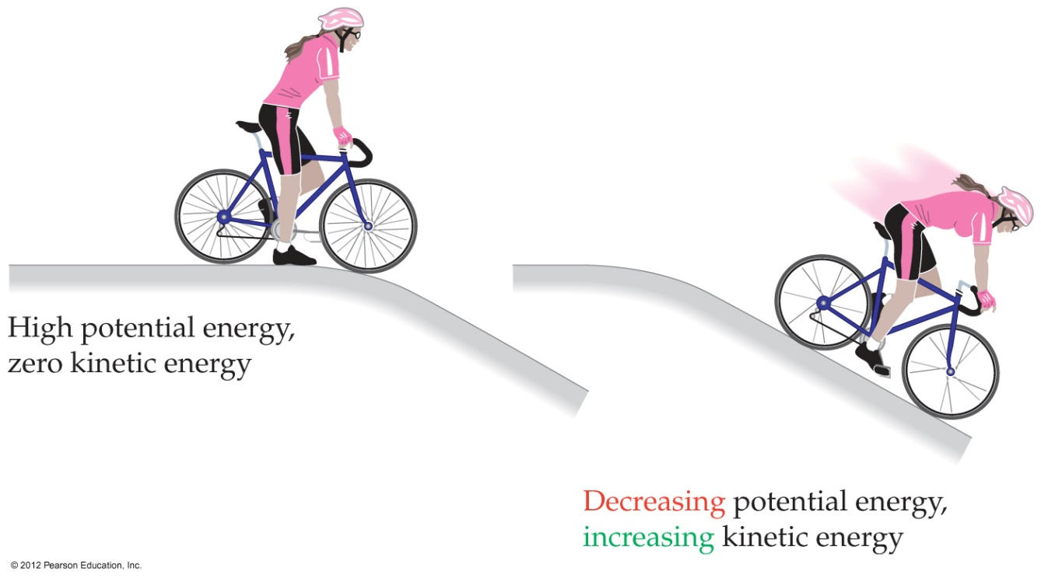
Kinetic Energy
Kinetic energy is energy an object possesses by virtue of its motion:
1
E_{k} = ⎯ mv²
2

Slide 4
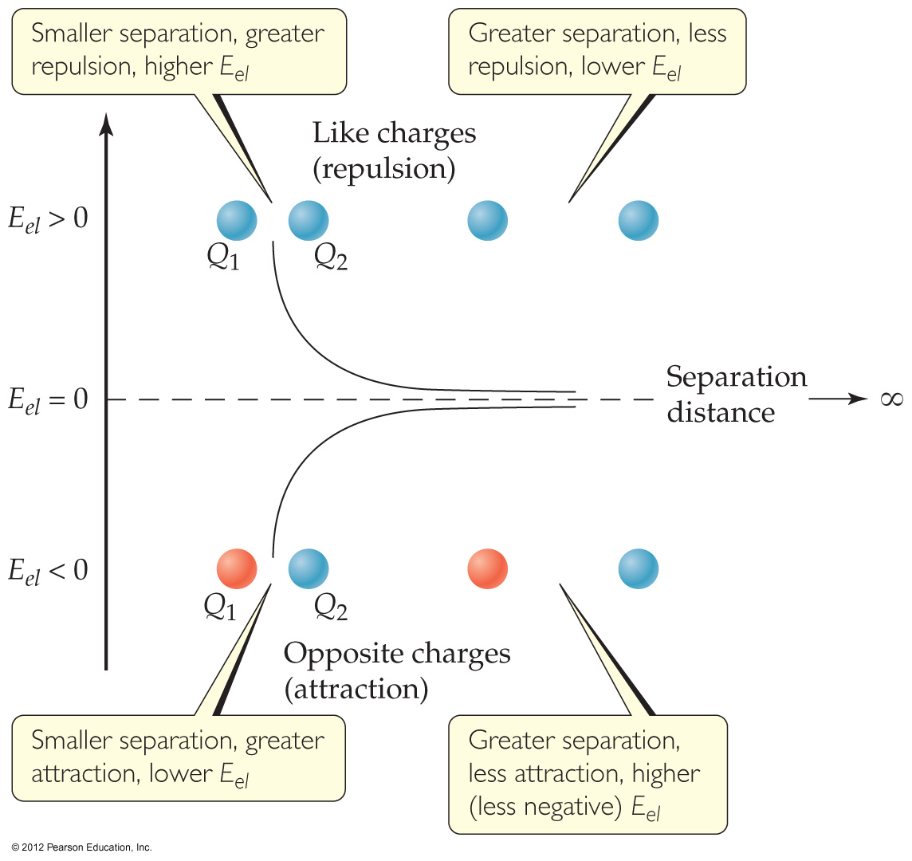
Potential Energy
Potential energy is energy an object possesses by virtue of its position or chemical composition.
The most important form of potential energy in molecules is electrostatic potential energy, E_{el}:
KQ₁Q₂
E_{el} =
d
K = 8.99×10⁹ J⋅m/C²

Slide 5
Units of Energy
The SI unit of energy is the joule (J):
An older, non-SI unit is still in widespread use: the calorie (cal):
1 cal = 4.184 J
1 Cal = 1000 cal = 1 kcal
kg m²
1 J = 1 ⎯⎯
s²

Slide 6
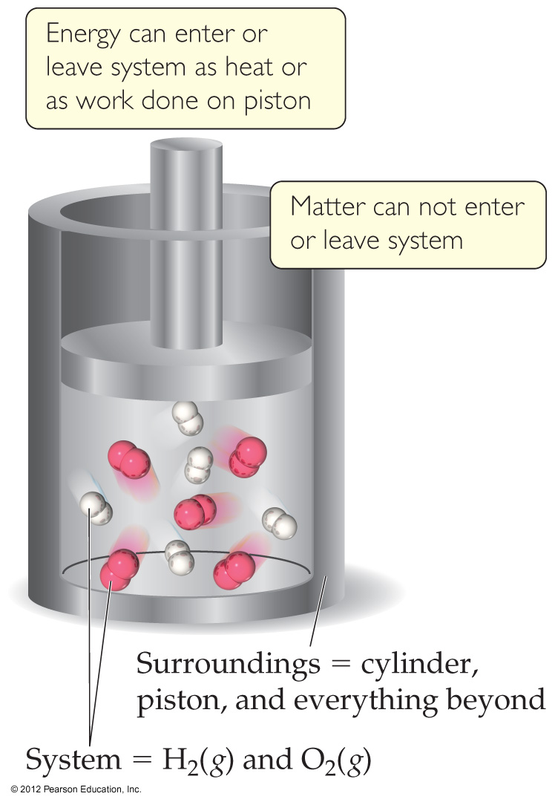
Definitions: System and Surroundings
The system includes the molecules we want to study (here, the hydrogen and oxygen molecules).
The surroundings are everything else (here, the cylinder and piston).

Slide 7
System
Open system: energy and matter can be exchanged with the surroundings.
Closed system: energy but not matter can be exchanged with the surroundings.
Isolated system: neither energy nor matter can be exchanged with the surroundings.

Slide 8


Closed system
Isolated system
Open system
What is the largest isolated system you have ever been aware of?
Notes:
Answer: C

Slide 9

Definitions: Work
Energy used to move an object over some distance is work:
w = F × d
where w is work, F is the force, and d is the distance over which the force is exerted.

Slide 10
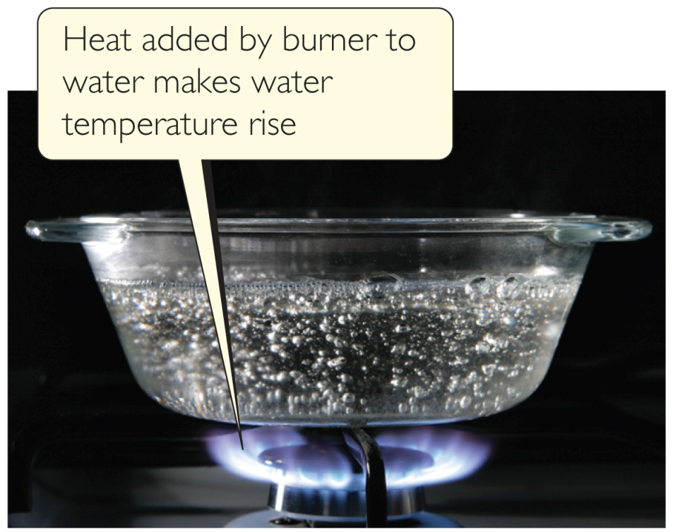
Heat
Energy can also be transferred as heat.
Heat flows from warmer objects to cooler objects.

Slide 11

Conversion of Energy
Energy can be converted from one type to another.
For example, the cyclist in Figure 5.2 has potential energy as she sits on top of the hill.

Slide 12
Conversion of Energy
As she coasts down the hill, her potential energy is converted to kinetic energy.
At the bottom, all the potential energy she had at the top of the hill is now kinetic energy.

Slide 13
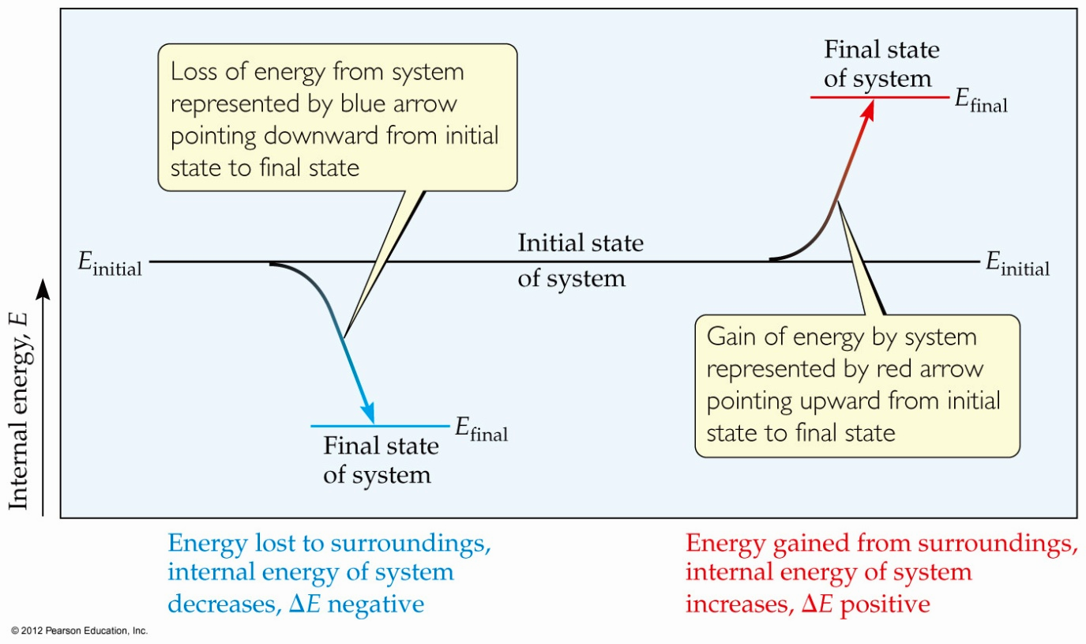
First Law of Thermodynamics
Energy is neither created nor destroyed.
In other words, the total energy of the universe is a constant; if the system loses energy, it must be gained by the surroundings, and vice versa.

Slide 14
Internal Energy
The internal energy of a system is the sum of all kinetic and potential energies of all components of the system; we call it E.

Slide 15
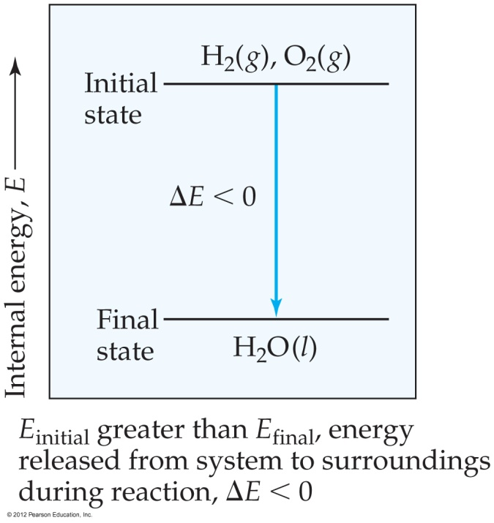
Internal Energy
By definition, the change in internal energy, ΔE, is the final energy of the system minus the initial energy of the system:
ΔE = E_{final} − E_{initial}

Slide 16
Changes in Internal Energy
If ΔE > 0, E_{final} > E_{initial}
  Therefore, the system absorbed energy from the surroundings.
  This energy change is called endergonic.

Slide 17
Changes in Internal Energy
If ΔE < 0, E_{final} < E_{initial}
  Therefore, the system released energy to the surroundings.
  This energy change is called exergonic.

Slide 18
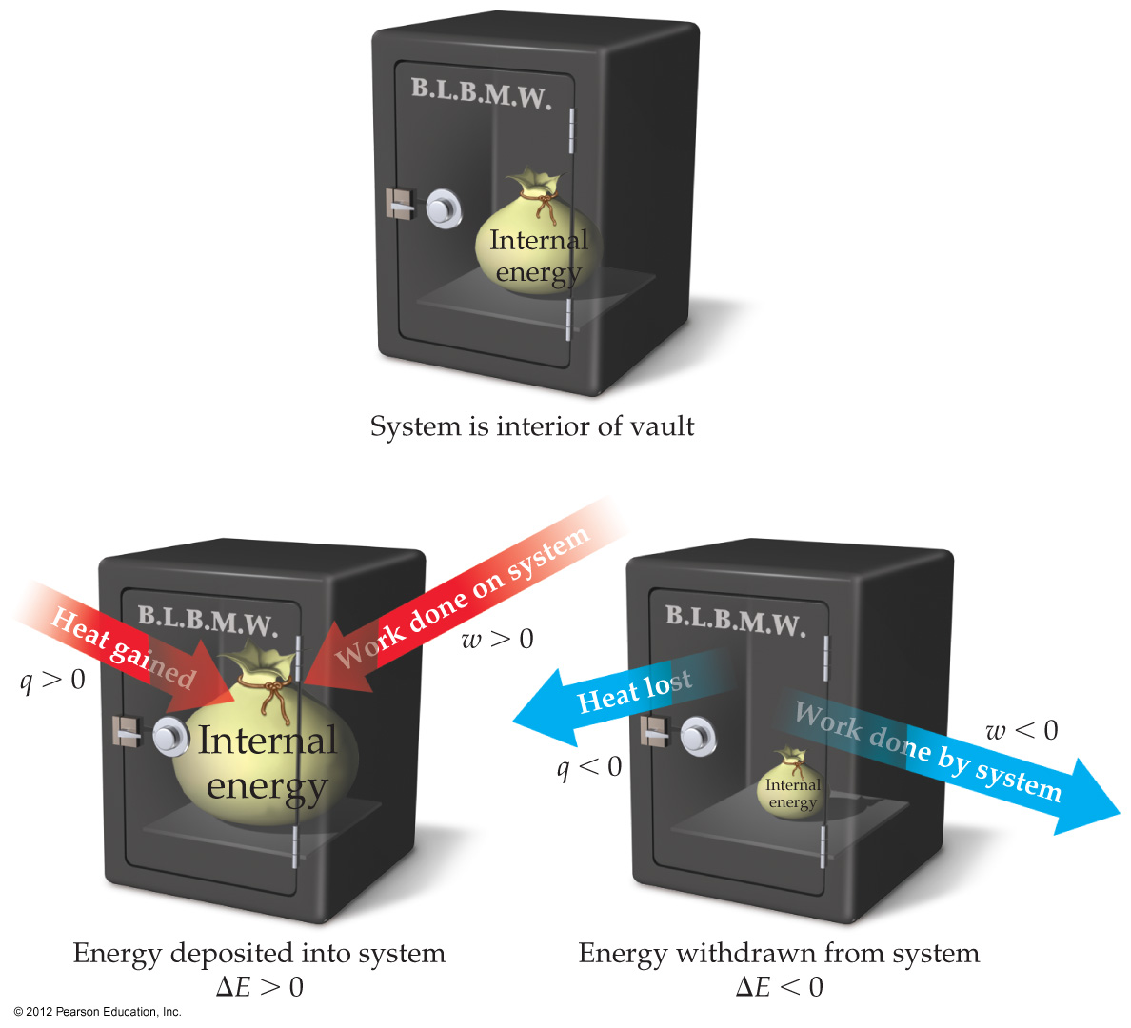
Changes in Internal Energy
When energy is exchanged between the system and the surroundings, it is exchanged as either heat (q) or work (w).
That is, ΔE = q + w.

Slide 19
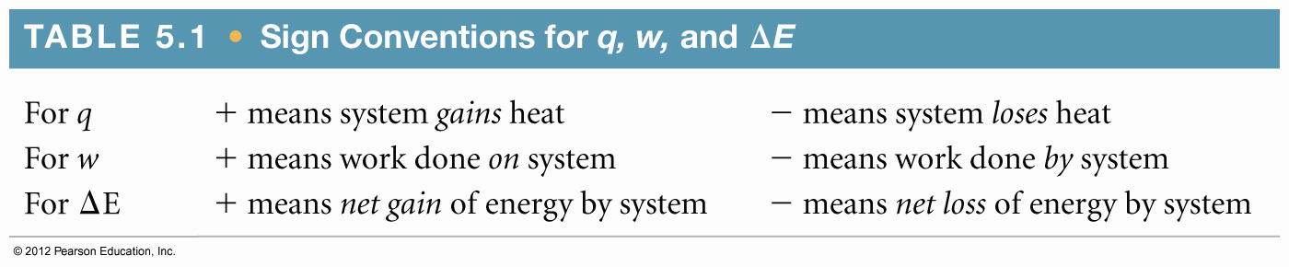
ΔE, q, w, and Their Signs

Slide 20
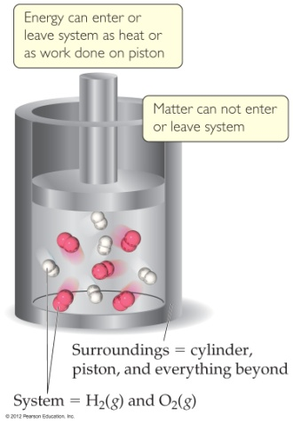
Sample Exercise 5.2 Relating Heat and Work to Changes of Internal Energy
Gases A(g) and B(g) are confined in a cylinder-and-piston arrangement like that in Figure 5.4
and react to form a solid product C(s): A(g) + B(g) C(s). As the reaction occurs,
the system loses 1150 J of heat to the surroundings. The piston moves downward as the
gases react to form a solid. As the volume of the gas decreases under the constant pressure
of the atmosphere, the surroundings do 480 J of work on the system. What is the change
in the internal energy of the system?
Solution
Analyze The question asks us to determine ΔE, given information about q and w.
Plan We first determine the signs of q and w (Table 5.1) and then use Equation 5.5, ΔE = q + w, to calculate ΔE.

Slide 21
Sample Exercise 5.2 Relating Heat and Work to Changes of Internal Energy
Continued
Solve Heat is transferred from the system to the surroundings, and work is done on the system by the surroundings, so
q is negative and w is positive: q = –1150 J and w = 480 kJ. Thus,
ΔE = q + w = (–1150 J) + (480 J) = –670 J
The negative value of ΔE tells us that a net quantity of 670 J of energy has been transferred from the system to the
surroundings.
Comment You can think of this change as a decrease of 670 J in the net value of the system’s energy bank account
(hence, the negative sign); 1150 J is withdrawn in the form of heat while 480 J is deposited in the form of work.
Notice that as the volume of the gases decreases, work is being done on the system by the surroundings, resulting in a
deposit of energy.
Practice Exercise
Calculate the change in the internal energy for a process in which a system absorbs 140 J of heat from the
surroundings and does 85 J of work on the surroundings.
Answer: +55 J

Slide 22
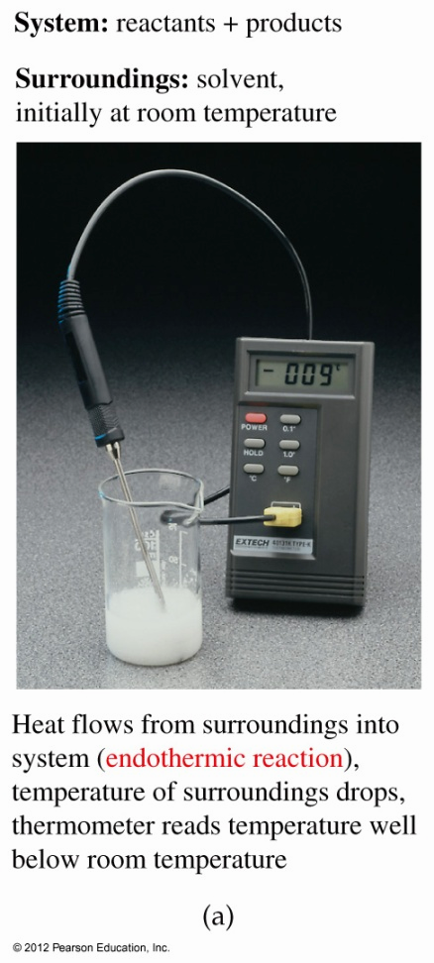
Exchange of Heat between System and Surroundings
When heat is absorbed by the system from the surroundings, the process is endothermic.

Slide 23
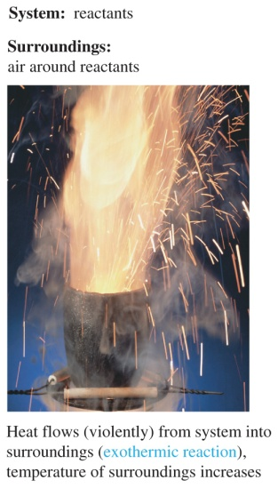
Exchange of Heat between System and Surroundings
When heat is absorbed by the system from the surroundings, the process is endothermic.
When heat is released by the system into the surroundings, the process is exothermic.

Slide 24
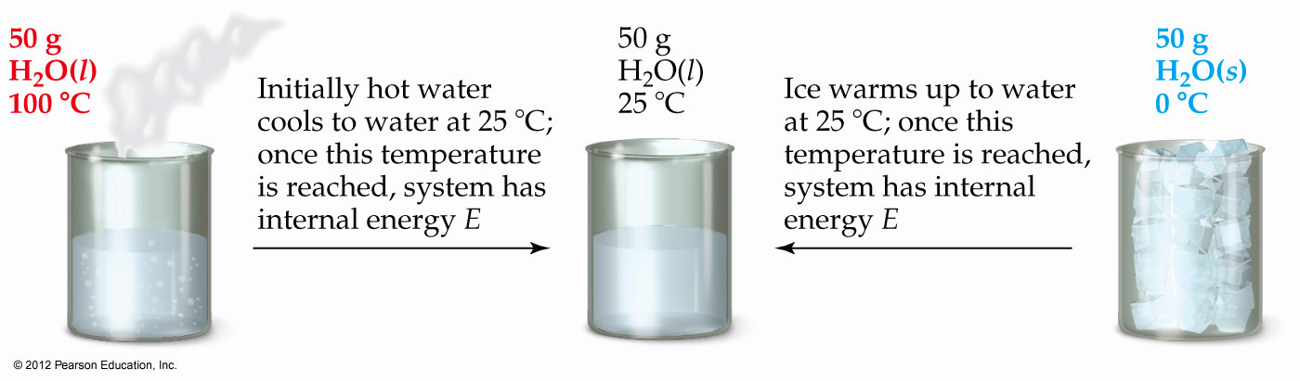
State Functions
Usually we have no way of knowing the internal energy of a system; finding that value is simply too complex a problem.

Slide 25
State Functions
However, we do know that the internal energy of a system is independent of the path by which the system achieved that state.
  In the system depicted in Figure 5.9, the water could have reached room temperature from either direction.

Slide 26
State Functions
Therefore, internal energy is a state function.
It depends only on the present state of the system, not on the path by which the system arrived at that state.
And so, ΔE depends only on E_{initial} and E_{final}.

Slide 27
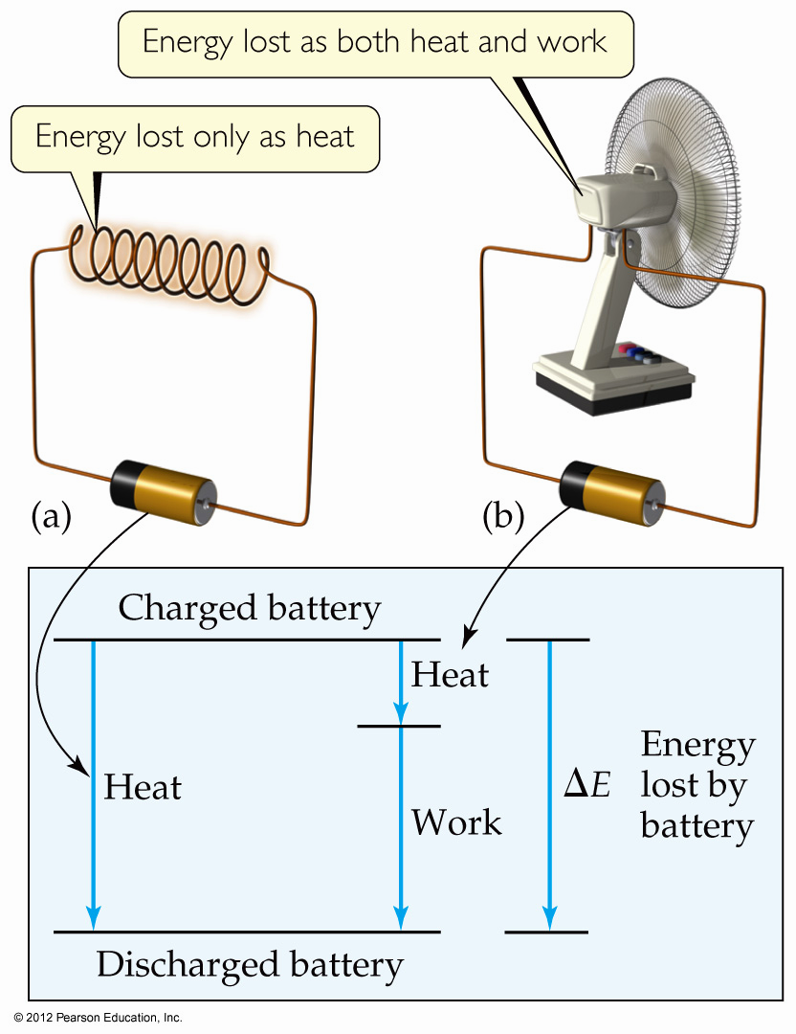
State Functions
However, q and w are not state functions.
Whether the battery is shorted out or is discharged by running the fan, its ΔE is the same.
  But q and w are different in the two cases.

Slide 28
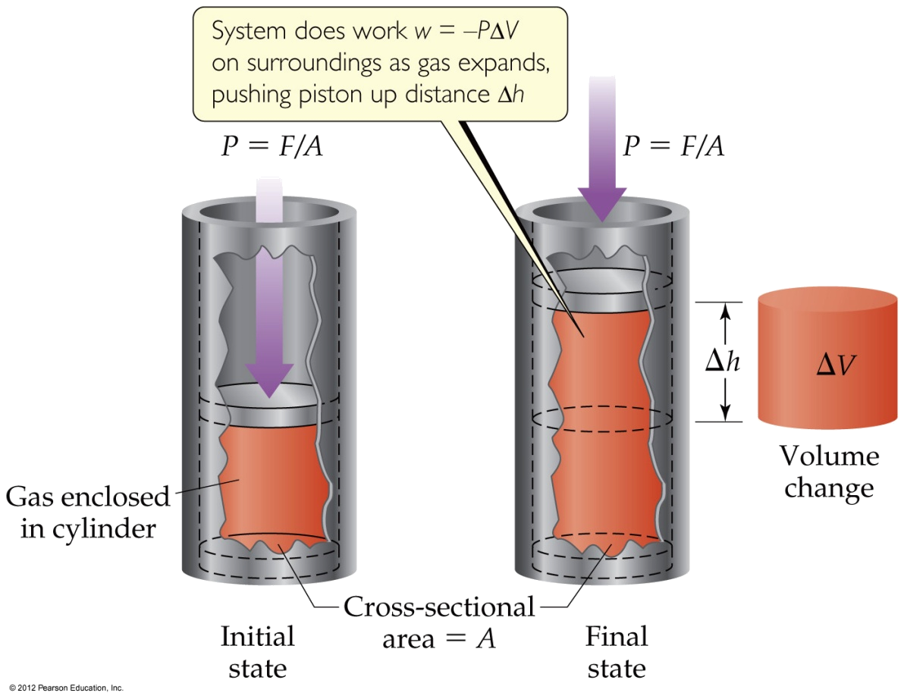
Work
Usually in an open container the only work done is by a gas pushing on the surroundings (or by the surroundings pushing on the gas).
P (Pressure) = F (Force) /A (Area); F = P×A
ΔV (volume) = A×Δh (distance)
w = −F×Δh = −P×A×Δh = −P×ΔV

Slide 29
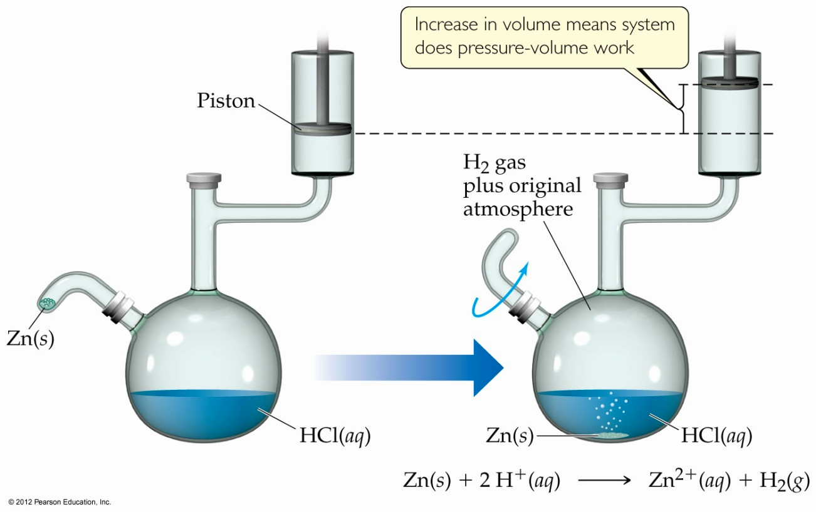
Work
We can measure the work done by the gas if the reaction is done in a vessel that has been fitted with a piston:
w = −PΔV

Slide 30

Yes, because pressure may change the value of work in w = –PΔV.
No, because ΔV = 0.
Notes:
Answer: B

Slide 31
Enthalpy
[en-thal-pee, en-thal-] /ˈɛnθælpi, ɛnˈθæl-/
If a process takes place at constant pressure (as the majority of processes we study do) and the only work done is this pressure–volume work, we can account for heat flow during the process by measuring the enthalpy of the system.
Enthalpy is the internal energy plus the product of pressure and volume:
H = E + PV

Slide 32
H is italicized in the equation.
E is a state function in the equation and this is the minimum requirement.
P and V are state functions in the equation and this is the minimum requirement.
All other terms in the equation, E, P and V, are state functions.
Notes:
Answer: D

Slide 33
Enthalpy
When the system changes at constant pressure, the change in enthalpy, ΔH, is
ΔH = Δ(E + PV)
This can be written
ΔH = ΔE + PΔV

Slide 34
Enthalpy
Since ΔE = q + w and w = −PΔV, we can substitute these into the enthalpy expression:
ΔH = ΔE + PΔV
ΔH = (q + w) − w
ΔH = q
So, at constant pressure, the change in enthalpy is the heat gained or lost.

Slide 35
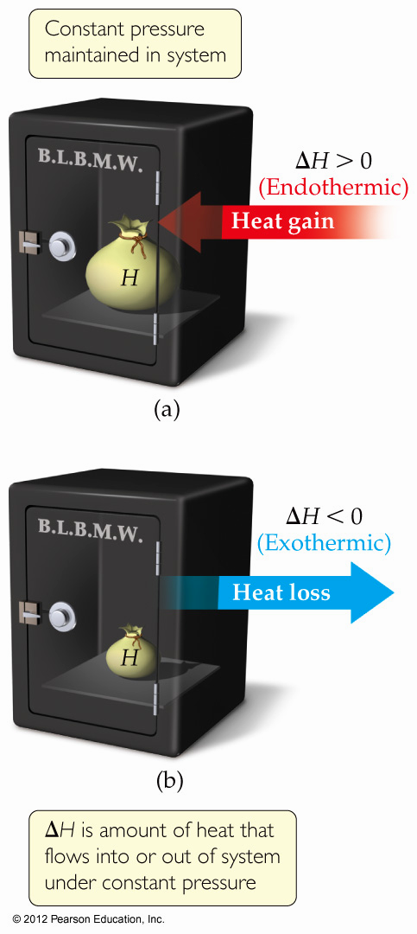
Endothermicity and Exothermicity
A process is endothermic when ΔH is positive.

Slide 36
Endothermicity and Exothermicity
A process is endothermic when ΔH is positive.
A process is exothermic when ΔH is negative.

Slide 37
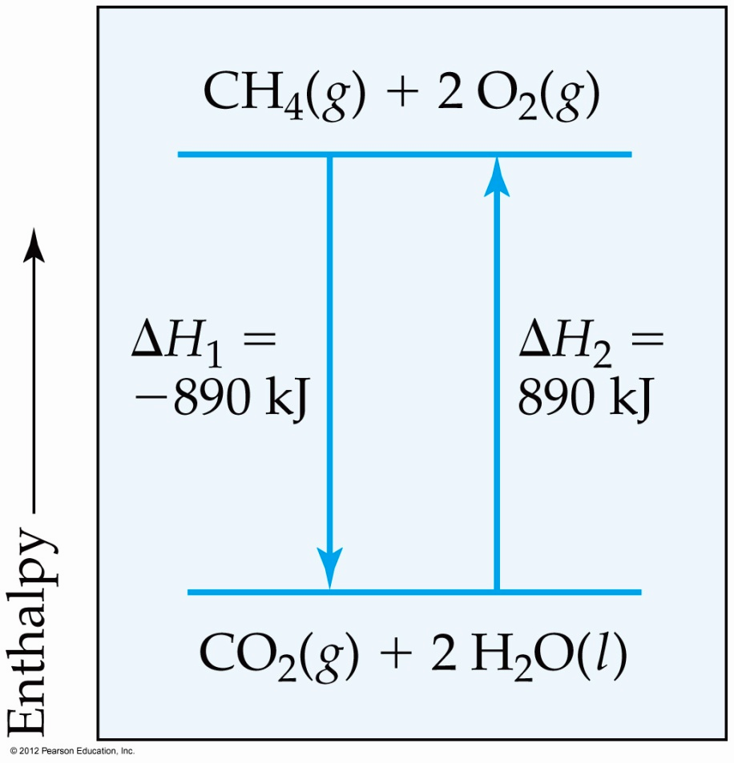
Enthalpy of Reaction
The change in enthalpy, ΔH, is the enthalpy of the products minus the enthalpy of the reactants:
ΔH = H_{products} − H_{reactants}

Slide 38
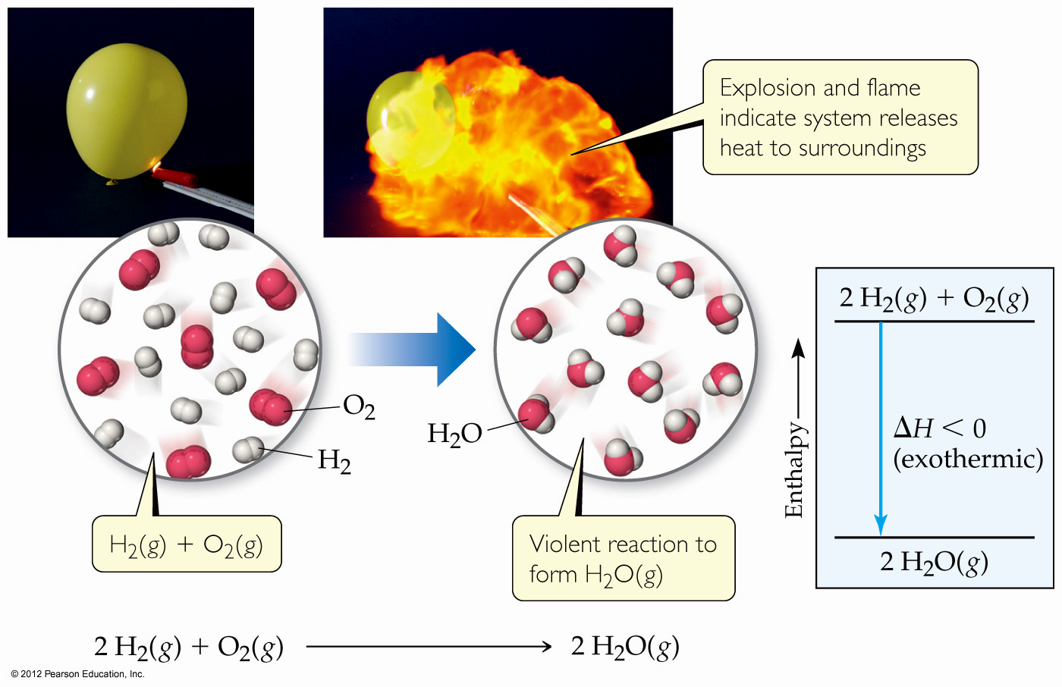
Enthalpy of Reaction
This quantity, ΔH, is called the enthalpy of reaction, or the heat of reaction.

Slide 39
The Truth about Enthalpy
Enthalpy is an extensive property.
ΔH for a reaction in the forward direction is equal in size, but opposite in sign, to ΔH for the reverse reaction.
ΔH for a reaction depends on the state of the products and the state of the reactants.

Slide 40

Ruler
Graduated cylinder
Barometer
Thermometer
Notes:
Answer: D

Slide 41
A moving racquetball has
kinetic energy.
potential energy.
work.
d. heat.
Notes:
Answer: a

Slide 42
A motionless racquetball has
kinetic energy.
potential energy.
work.
d. heat.
Notes:
Answer: b

Slide 43
As the racquetball game progresses, the players perspire, giving off
kinetic energy.
potential energy.
work.
d. heat.
Notes:
Answer: d

Slide 44
Work = _______.
force x distance
force / distance
energy x distance
d. energy / distance
Notes:
Answer: a

Slide 45
The sum of all of the kinetic and potential energies of a system is called the
integral energy.
dynamic energy.
internal energy.
d. work.
Notes:
Answer: c

Slide 46
A system absorbs heat during an _______ process.
exothermic
isothermal
adiabatic
d. endothermic
Notes:
Answer: d

Slide 47
If X is a state function, then the change in X is given by (X_{final} _______ X_{initial}).
+
–
×
d. ÷
Notes:
Answer: b

Slide 48
Which of these is NOT a state function?
internal energy
temperature
enthalpy
d. work
Notes:
Answer: d

Slide 49
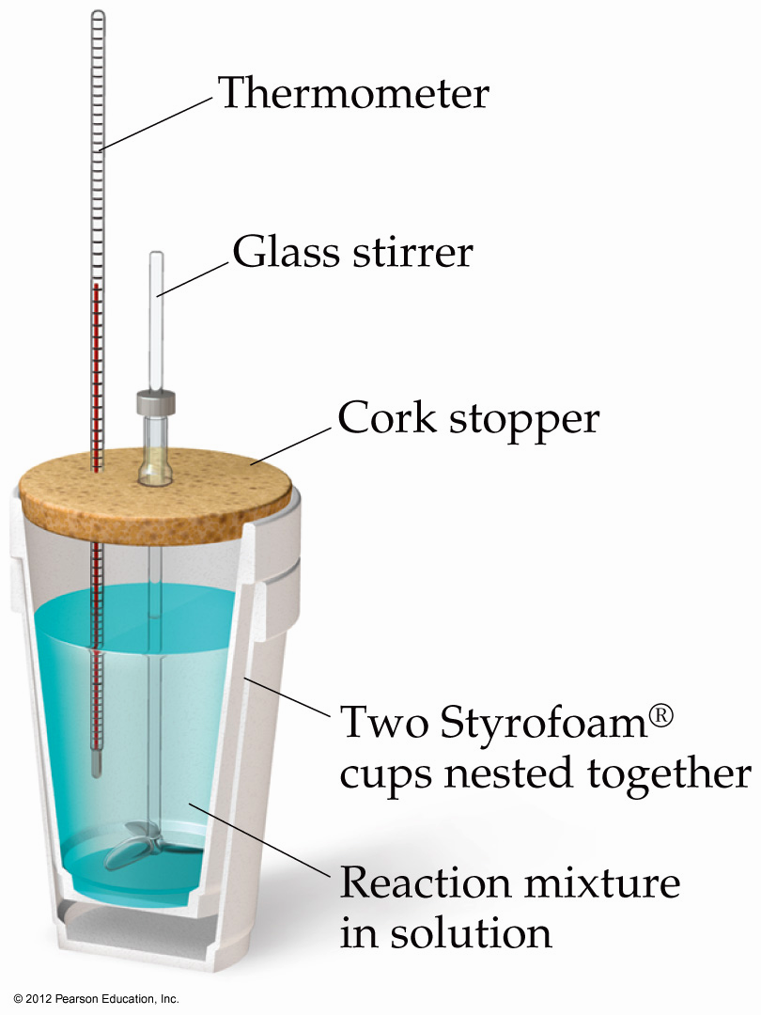
Calorimetry (method) – calorimeter (device)
Since we cannot know the exact enthalpy of the reactants and products, we measure ΔH through calorimetry, the measurement of heat flow.

Slide 50
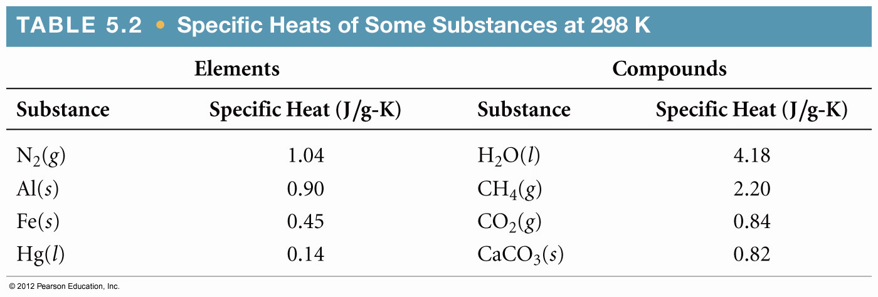
Heat Capacity and Specific Heat
The amount of energy required to raise the temperature of a substance by 1 K (1°C) is its heat capacity.

Slide 51
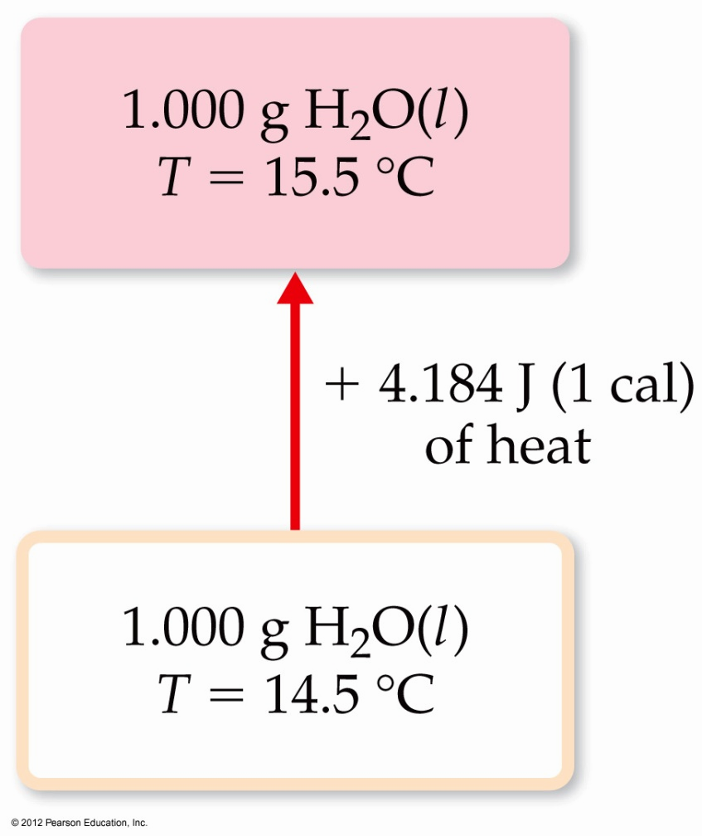
Heat Capacity and Specific Heat
We define specific heat capacity (or simply specific heat) as the amount of energy required to raise the temperature of 1 g of a substance by 1 K (or 1 °C).

Slide 52
Heat Capacity and Specific Heat
Specific heat, then, is
heat transferred
Specific heat =
mass × temperature change
q
s =
m × ΔT

Slide 53
Constant Pressure (heat versus ΔH) Calorimetry
By carrying out a reaction in aqueous solution in a simple calorimeter such as this one, one can indirectly measure the heat change for the system by measuring the heat change for the water in the calorimeter.

Slide 54
Constant Pressure Calorimetry
Because the specific heat for water is well known (4.184 J/g-K), we can measure ΔH for the reaction with this equation:
q = m × s × ΔT
Specific heat

Slide 55
Sample Exercise 5.6 Measuring ΔH Using a Coffee-Cup Calorimeter
When a student mixes 50 mL of 1.0 M HCl and 50 mL of 1.0 M NaOH in a coffee-cup calorimeter, the temperature of the resultant solution increases from 21.0 °C to 27.5 °C. Calculate the enthalpy change for the reaction in kJ/mol HCl, assuming that the calorimeter loses only
a negligible quantity of heat, that the total volume of the solution is 100 mL, that its density is
1.0 g/mL, and that its specific heat is 4.18 J/g–K.
Solution
Analyze Mixing solutions of HCl and NaOH results in an acid–base reaction:
HCl(aq) + NaOH(aq) H₂O(l) + NaCl(aq)
We need to calculate the heat produced per mole of HCl, given the temperature increase of the solution, the number
of moles of HCl and NaOH involved, and the density and specific heat of the solution.
Plan The total heat produced can be calculated using Equation 5.23. The number of moles of HCl consumed in the
reaction must be calculated from the volume and molarity of this substance, and this amount is then used to determine
the heat produced per mol HCl.
Solve
Because the total volume of the solution is 100 mL, its
mass is
The temperature change is
Using Equation 5.23, we have
(100 mL)(1.0 g/mL) = 100 g
ΔT = 27.5 °C – 21.0 °C = 6.5 °C = 6.5 K
q_{rxn} = –C_{s} × m × ΔT
= –(4.18 J/g–K)(100 g)(6.5 K) = –2.7 × 10³ J = –2.7 kJ

Slide 56
Sample Exercise 5.6 Measuring ΔH Using a Coffee-Cup Calorimeter
Continued
Because the process occurs at constant pressure,
To express the enthalpy change on a molar basis, we use
the fact that the number of moles of HCl is given by the
product of the volume (50mL = 0.050 L) and
concentration (1.0 M = 1.0 mol/L) of the HCl solution:
Thus, the enthalpy change per mole of HCl is
ΔH = q_{P} = –2.7 kJ
(0.050 L)(1.0 mol/L) = 0.050 mol
ΔH = –2.7 kJ/0.050 mol = –54 kJ/mol
Check ΔH is negative (exothermic), which is expected for the reaction of an acid with a base and evidenced by the
fact that the reaction causes the temperature of the solution to increase. The magnitude of the molar enthalpy
change seems reasonable.
Practice Exercise
When 50.0 mL of 0.100 MAgNO3 and 50.0 mL of 0.100 M HCl are mixed in a constant-pressure calorimeter,
the temperature of the mixture increases from 22.30 °C to 23.11 °C. The temperature increase is caused by the following reaction:
AgNO3(aq) + HCl(aq) AgCl(s) + HNO3(aq)
Calculate ΔH for this reaction in AgNO3, assuming that the combined solution has a mass of 100.0 g and a specific heat of 4.18 J/g °C.
Answer: –68,000 J/mol = –68 kJ/mol

Slide 57
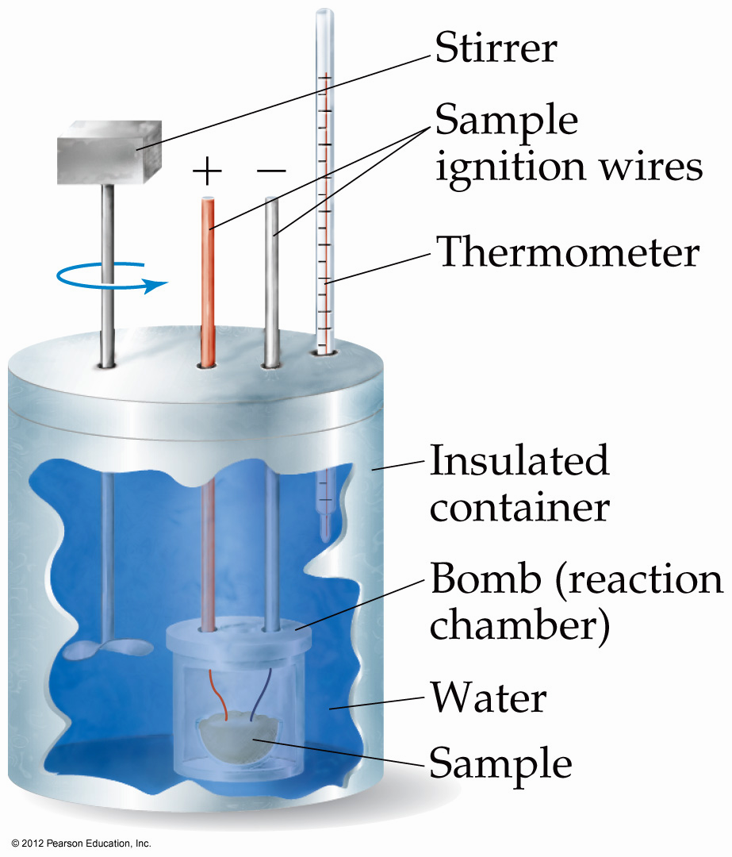
Bomb Calorimetry (fixed volume but not pressure)
Reactions can be carried out in a sealed “bomb” such as this one.
The heat absorbed (or released) by the water is a very good approximation of the enthalpy change for the reaction.

Slide 58
Bomb Calorimetry
Because the volume in the bomb calorimeter is constant, what is measured is really the change in internal energy, ΔE, not ΔH.
For most reactions, the difference is very small.

Slide 59
Bomb Calorimetry
ΔE = q + w
If P-V work is the only work that can be done,
ΔE = q − PΔV
When the reaction is carried out in a constant-volume container (ΔV = 0),
ΔE = q_{v}
Most reactions are run under constant pressure,
ΔE = q_{P} − PΔV
ΔE + PΔV = q_{P}
Δ(E + PV) = q_{P} H = E + PV (a new state function)
ΔH = q_{P}

Slide 60
Sample Exercise 5.7 Measuring q_{rxn} Using a Bomb Calorimeter
The combustion of methylhydrazine (CH₆N₂), a liquid rocket fuel, produces N₂(g), CO₂(g), and H₂O(l):
2 CH₆N₂(l) + 5 O₂(g) 2 N₂(g) + 2 CO₂(g) + 6 H₂O(l)
When 4.00 g of methylhydrazine is combusted in a bomb calorimeter, the temperature of the calorimeter increases
from 25.00 °C to 39.50 °C. In a separate experiment the heat capacity of the calorimeter is measured to be 7.794 kJ/ °C. Calculate the heat of reaction for the combustion of a mole of CH₆N₂.
Solution
Analyze We are given a temperature change and the total heat capacity of the calorimeter. We are also given the
amount of reactant combusted. Our goal is to calculate the enthalpy change per mole for combustion of the reactant.
Plan We will first calculate the heat evolved for the combustion of the 4.00-g sample. We will then convert
this heat to a molar quantity.
Solve
For combustion of the 4.00-g sample of methylhydrazine,
the temperature change of the calorimeter is
We can use ΔT and the value for C_{cal} to calculate the heat
of reaction (Equation 5.24):
We can readily convert this value to the heat of reaction
for a mole of CH₆N₂:
ΔT = (39.50 °C – 25.00 °C) = 14.50 °C
q_{rxn} = –C_{cal} × ΔT = –(7.794 kJ/°C)(14.50 °C) = –113.0 kJ

Slide 61
Enthalpies of Formation
An enthalpy of formation, ΔH_{f}, is defined as the enthalpy change for the reaction in which a compound is made from its constituent elements in their elemental forms.

Slide 62
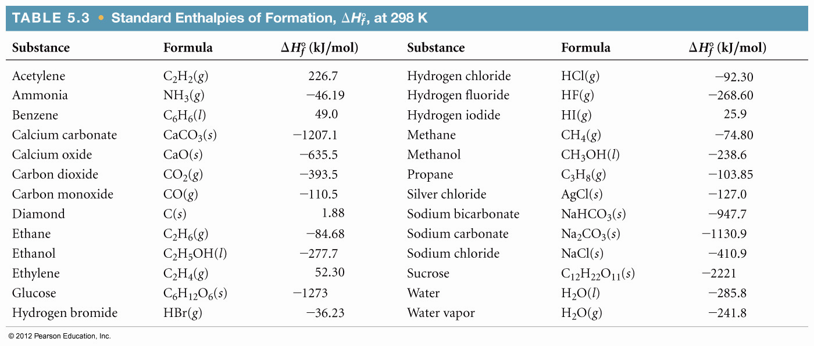
Standard Enthalpies of Formation
Standard enthalpies of formation, ΔH_{f}º, are measured under standard conditions (25 ºC and 1.00 atm pressure).

Slide 63
Standard Enthalpies of Formation
By definition, the standard enthalpy of formation of the most stable form of any element is zero because there is no formation reaction needed when the element is already in its standard state.
Thus, the values of ΔH_{f}º for C(graphite), H₂(g), O₂(g), and the standard states of other elements are zero by definition.
See Table 5.3 and Appendix C for listed ΔH_{f}º data.

Slide 64
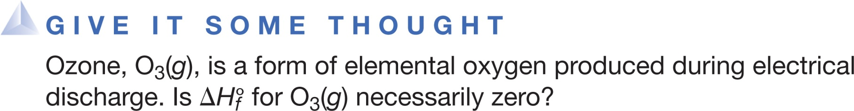
Yes, because it is just another elemental form of oxygen.
No, because it is not the most stable form of the element oxygen at the given conditions.
Yes, because changing the subscripts of an elemental formula does not change standard heat of formation.
No, because there is a temperature change when ozone is formed.
Notes:
Answer: B

Slide 65

Sample Exercise 5.10 Equations Associated with Enthalpies of Formation
For which of these reactions at 25 °C does the enthalpy change represent a standard enthalpy of formation? For each that does not, what changes are needed to make it an equation whose ΔH is an enthalpy of formation?
(a)
(b)
(c)
Solution
Analyze The standard enthalpy of formation is represented by a reaction in which each reactant is an element in its
standard state and the product is one mole of the compound.
Plan We need to examine each equation to determine (1) whether the reaction is one in which one mole of substance
is formed from the elements, and (2) whether the reactant elements are in their standard states.
Solve In (a) 1 mol Na₂O is formed from the elements sodium and oxygen in their proper states, solid Na and O₂ gas,
respectively. Therefore, the enthalpy change for reaction (a) corresponds to a standard enthalpy of formation.
In (b) potassium is given as a liquid. It must be changed to the solid form, its standard state at room temperature.
Furthermore, two moles of product are formed, so the enthalpy change for the reaction as written is twice the standard
enthalpy of formation of KCl(s). The equation for the formation reaction of 1 mol of KCl(s) is

Slide 66
Sample Exercise 5.10 Equations Associated with Enthalpies of
Formation
Continued
Reaction (c) does not form a substance from its elements. Instead, a substance decomposes to its elements, so this
reaction must be reversed. Next, the element carbon is given as diamond, whereas graphite is the standard state of
carbon at room temperature and 1 atm pressure. The equation that correctly represents the enthalpy of formation of
glucose from its elements is
6 C(graphite) + 6 H₂(g) + 3 O₂(g) C₆H₁₂O₆(s)
Practice Exercise
Write the equation corresponding to the standard enthalpy of formation of liquid carbon tetrachloride (CCl₄).
Answer: C(graphite) + 2 Cl₂(g) CCl₄(l)

Slide 67
Hess’s Law
ΔH is well known for many reactions, and it is inconvenient to measure ΔH for every reaction in which we are interested.
However, we can estimate ΔH using published ΔH values and the properties of enthalpy.
from known reactions to unknown reactions

Slide 68
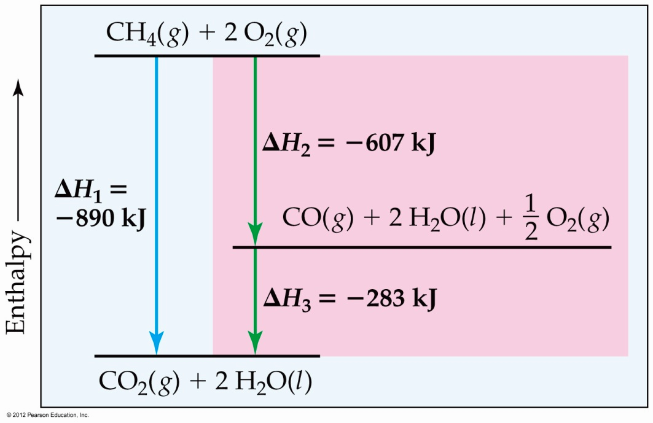
Hess’s Law
Hess’s law states that “if a reaction is carried out in a series of steps, ΔH for the overall reaction will be equal to the sum of the enthalpy changes for the individual steps.”

Slide 69
Hess’s Law
Because ΔH is a state function, the total enthalpy change depends only on the initial state of the reactants and the final state of the products.

Slide 70
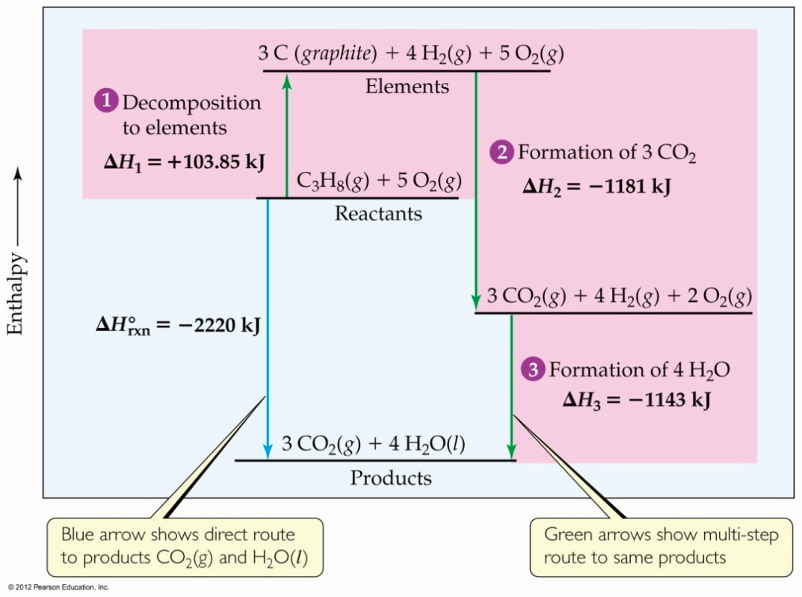
Calculation of ΔH
C₃H₈(g) + 5O₂(g) ⎯→ 3CO₂(g) + 4H₂O(l)
Imagine this as occurring
in three steps:
C₃H₈(g) ⎯→ 3C_{(graphite)} + 4H₂(g)
3C_{(graphite)} + 3O₂(g) ⎯→3CO₂(g)
4H₂(g) + 2O₂(g) ⎯→ 4H₂O(l)

Slide 71
Calculation of ΔH
C₃H₈(g) + 5O₂(g) ⎯→ 3CO₂(g) + 4H₂O(l)
The sum of these equations is
C₃H₈(g) ⎯→ 3C_{(graphite)} + 4H₂(g)
3C_{(graphite)} + 3O₂(g) ⎯→3CO₂(g)
4H₂(g) + 2O₂(g) ⎯→ 4H₂O(l)
C₃H₈(g) + 5O₂(g) ⎯→ 3CO₂(g) + 4H₂O(l)

Slide 72
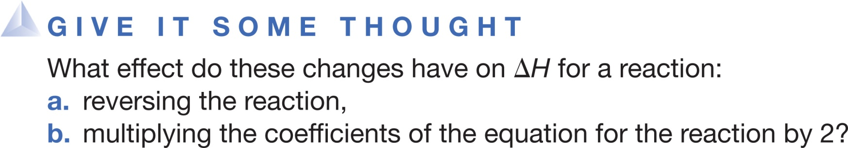

a.
No change.
Sign of changes.
Value of increases.
Value of decreases.
b.
No change.
Sign of changes.
Value of doubles.
Value of decreases by half.
Notes:
Answer: B

Slide 73
Calculation of ΔH
We can use Hess’s law in this way:
ΔH = ΣnΔH_{f}º_{,products} – ΣmΔH_{f}º_{,reactants}
where n and m are the stoichiometric coefficients.

Slide 74
Standard Enthalpies of Formation
Standard enthalpies of formation, ΔH_{f}º, are measured under standard conditions (25 ºC and 1.00 atm pressure).

Slide 75
Sample Exercise 5.11 Calculating an Enthalpy of Reaction from
Enthalpies of Formation
(a) Calculate the standard enthalpy change for the combustion of 1 mol of benzene, C₆H₆(l), to CO₂(g) and H₂O(l). (b) Compare the quantity of heat produced by combustion of 1.00 g propane with that produced by 1.00 g benzene.
Solution
Analyze (a) We are given a reaction [combustion of
C₆H₆(l) to form CO₂(g) and H₂O(l)] and asked to
calculate its standard enthalpy change, ΔH°. (b) We then
need to compare the quantity of heat produced by
combustion of 1.00 g C₆H₆ with that produced by
1.00 g C₃H₈, whose combustion was treated previously
in the text. (See Equations 5.29 and 5.30.)
Plan (a) We need to write the balanced equation for the
combustion of C₆H₆.We then look up values in
Appendix C or in Table 5.3 and apply Equation 5.31 to
calculate the enthalpy change for the reaction. (b) We
use the molar mass of C₆H₆ to change the enthalpy
change per mole to that per gram. We similarly use the
molar mass of C₃H₈ and the enthalpy change per mole
calculated in the text previously to calculate the enthalpy
change per gram of that substance.
Solve
(a) We know that a combustion reaction involves O₂(g)
as a reactant. Thus, the balanced equation for the
combustion reaction of 1 mol C₆H₆(l) is

Slide 76
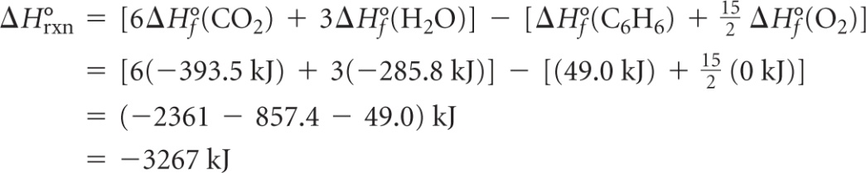



Sample Exercise 5.11 Calculating an Enthalpy of Reaction from
Enthalpies of Formation
Continued
We can calculate ΔH° for this reaction by using Equation
5.31 and data in Table 5.3. Remember to multiply the
value for each substance in the reaction by that
substance’s stoichiometric coefficient. Recall also that
for any element in its most stable form under
standard conditions, so
(b) From the example worked in the text,
for the combustion of 1 mol of propane. In part (a) of
this Exercise we determined that
for the combustion of 1 mol benzene. To determine the
heat of combustion per gram of each substance, we use
the molar masses to convert moles to grams:
C₃H₈(g): (–2220 kJ/mol)(1 mol/44.1 g) = –50.3 kJ/g
C₆H₆(l): (–3267 kJ/mol)(1 mol/78.1 g) = –41.8 kJ/g

Slide 77
Sample Exercise 5.11 Calculating an Enthalpy of Reaction from
Enthalpies of Formation
Continued
Comment Both propane and benzene are hydrocarbons. As a rule, the energy obtained from the combustion
of a gram of hydrocarbon is between 40 and 50 kJ.
Practice Exercise
Use Table 5.3 to calculate the enthalpy change for the combustion of 1 mol of ethanol:
C₂H₅OH(l) + 3 O₂(g) 2 CO₂(g) + 3 H₂O(l)
Answer: –1637 kJ

Slide 78
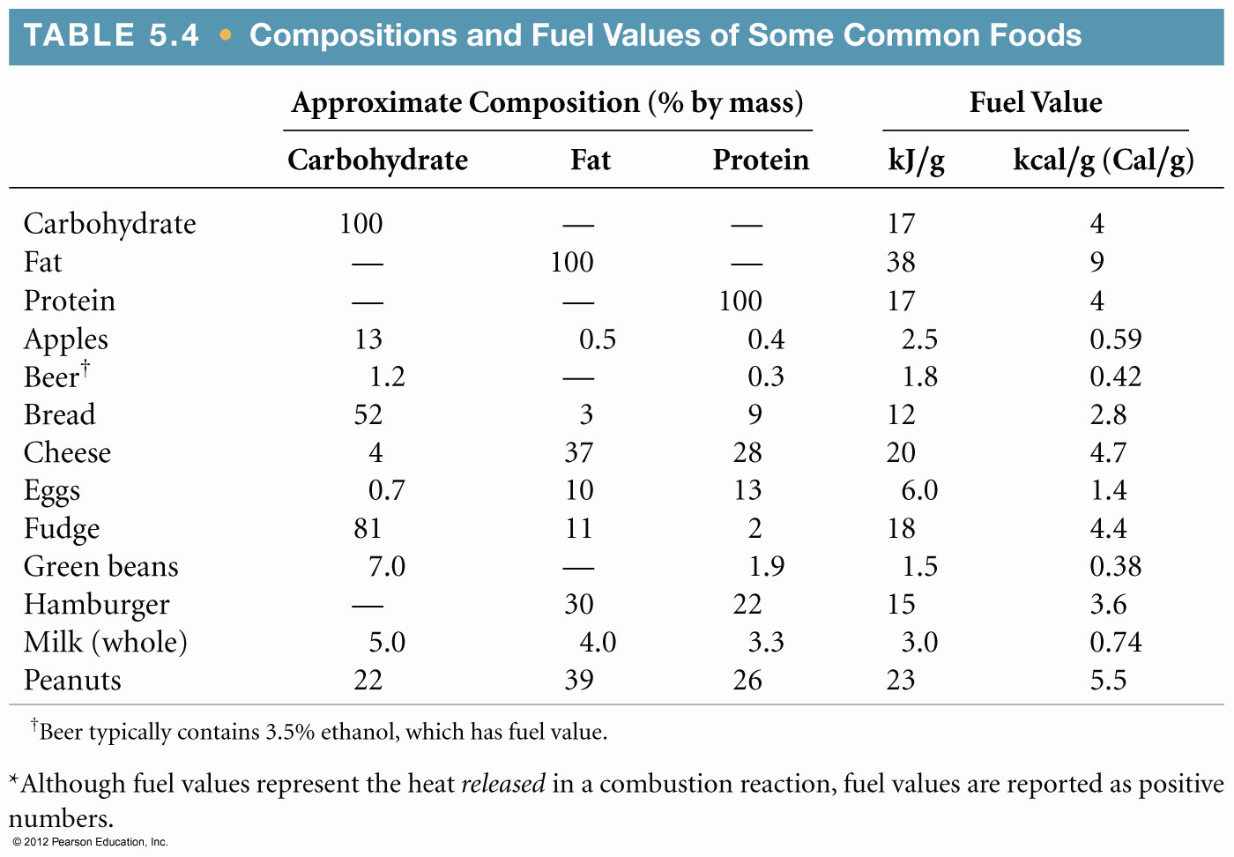
Energy in Foods
Most of the fuel in the food we eat comes from carbohydrates and fats.

Slide 79
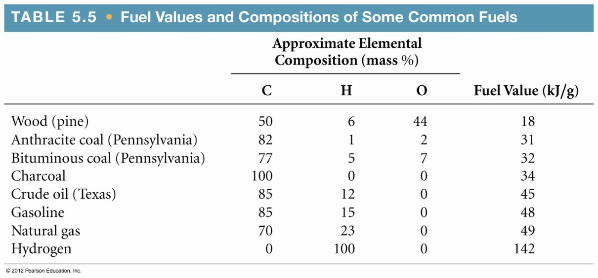
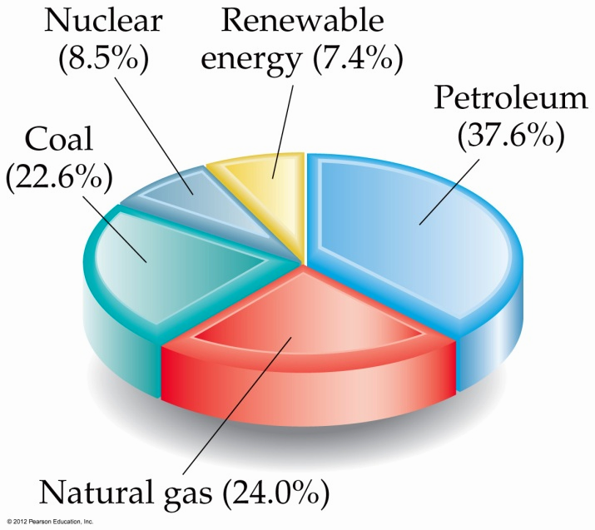
Energy in Fuels
The vast majority of the energy consumed in the USA comes from fossil fuels.

Slide 80
When a piece of iron at 356 Kelvins is placed in water at 298 Kelvins, what happens?
Energy flows from iron to water.
Energy flows from water to iron.
Energy does not flow.
d. Energy is not conserved.
Notes:
Answer: a

Slide 81
A substance’s specific heat is its heat capacity per
mole.
gram.
joule.
d. kelvin.
Notes:
Answer: b

Slide 82
The standard enthalpy of formation of carbon in its graphite form is _______ kilojoules per mole.
100
1000
1
d. 0
Notes:
Answer: d

Slide 83
The standard enthalpy of formation of carbon in its diamond form is +1.88 kJ/mole, which means that diamond is _______ graphite.
as stable as
more stable than
less stable than
d. an isotope of
Notes:
Answer: c

Slide 84
2 H₂ + O₂ → 2 H₂O
If the reaction above releases 483.6 kJ, then the standard enthalpy of formation of H₂O =
–483.6 kJ/mole.
+483.6 kJ/mole.
–241.8 kJ/mole.
d. +241.8 kJ/mole.
Notes:
Answer: c

Slide 85
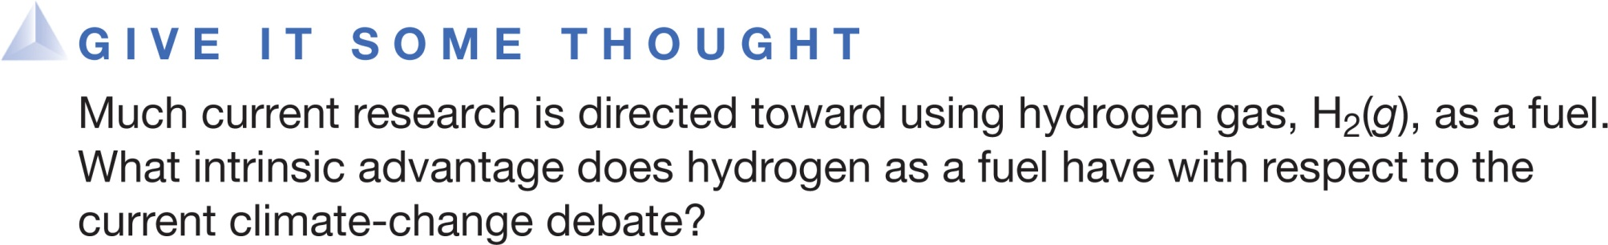
It is easily stored as a gas for a long time.
Its product of combustion is only H₂O(g).
Safety considerations using hydrogen gas are minimal.
It is easily found in nature as an element.
Notes:
Answer: B

Slide 86
The average fuel values for proteins, carbohydrates, and fats are, respectively,
_______ kilocalories per gram.
4, 4, and 4
4, 4, and 9
4, 9, and 4
d. 9, 4, and 4
Notes:
Answer: b

Slide 87
Which of these is NOT a renewable form of energy?
nuclear energy
solar energy
geothermal energy
d. hydroelectric energy
Notes:
Answer: a

